Slide 1
Semiconductor Sources for Optical Communications
Xavier Fernando
ADROIT Lab
(Figures: Gird Keiser)

Slide 2
Considerations with Optical Sources
Physical dimensions to suit the fiber
Narrow radiation pattern (beam width)
Linearity (output light power proportional to driving current)

Slide 3
Considerations with Optical Sources
Ability to be directly modulated by varying driving current
Fast response time (wide band)
Adequate output power into the fiber

Slide 4
Considerations…
Narrow spectral width (or line width)
Stability and efficiency
Driving circuit issues
Reliability and cost

Slide 5
Semiconductor Light Sources
A PN junction (that consists of direct band gap semiconductor materials) acts as the active or recombination region
When the PN junction is forward biased, electrons and holes recombine either radiatively (emitting photons) or non-radiatively (emitting heat). This is simple LED operation.
In an LASER, the photon is further processed in a resonance cavity to achieve a coherent, highly directional optical beam with narrow linewidth

Slide 6
Light Emission
Basic LED operation: When an electron jumps from a higher energy state (E_{c}) to a lower energy state (E_{v}) the difference in energy E_{c}- E_{v} is released either
  as a photon of energy E = hν (radiative recombination)
  as heat (non-radiative recombination)

Slide 7
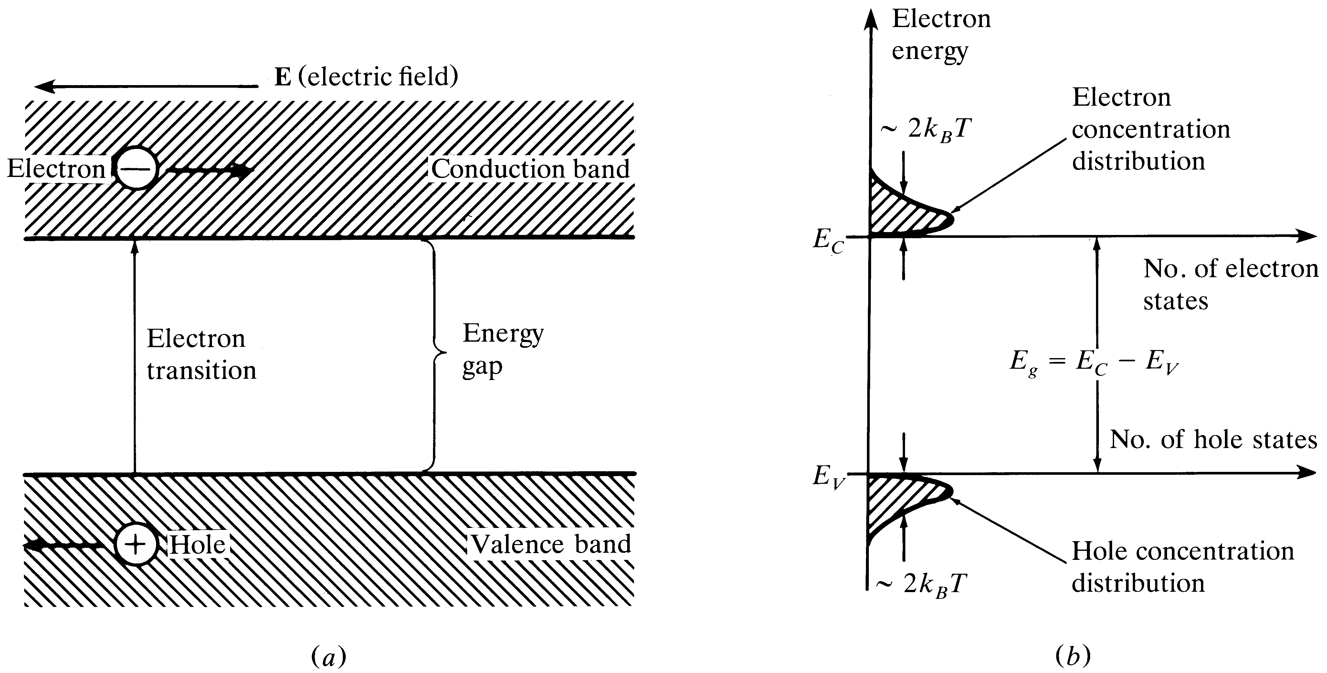
Energy-Bands
In a pure Gp. IV material, equal number of holes and electrons
exist at different energy levels.
Notes:
1

Slide 8
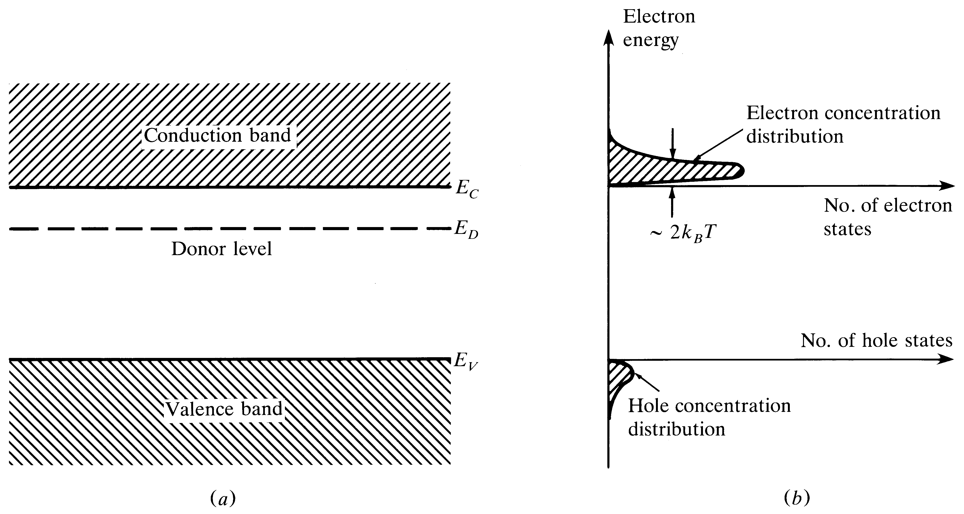
n-type material
Adding group V impurity will create an n- type material
Notes:
2

Slide 9
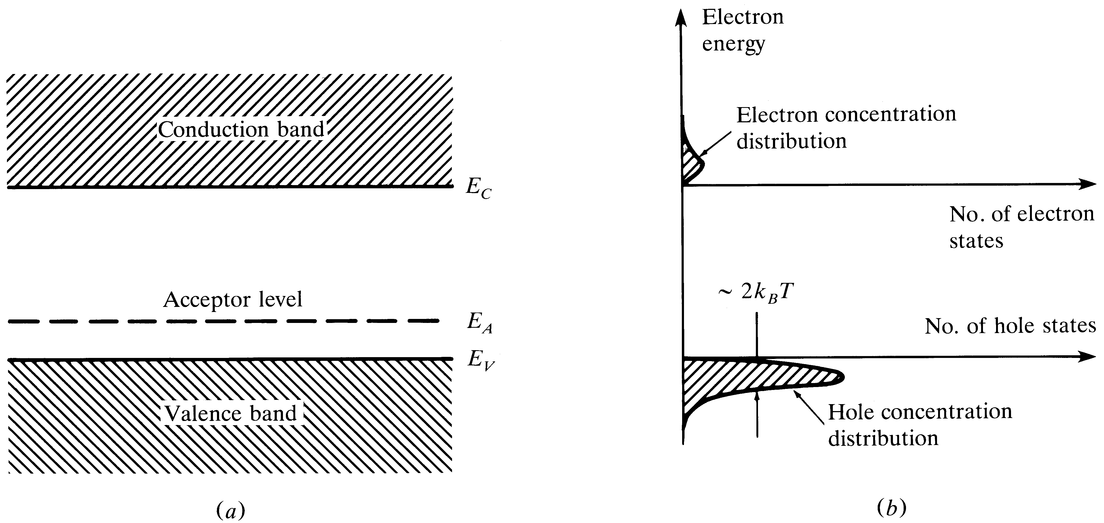
p-type material
Adding group III impurity will create a p-type material
Notes:
3

Slide 10
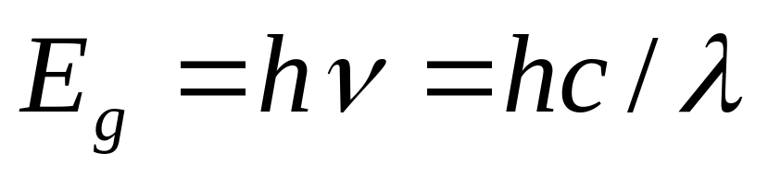
The Light Emitting Diode (LED)
For fiber-optics, the LED should have a high radiance (light intensity), fast response time and a high quantum efficiency
Double or single hetero-structure devices
Surface emitting (diffused radiation) Vs Edge emitting (more directional) LED’s
Emitted wavelength depends on bandgap energy

Slide 11
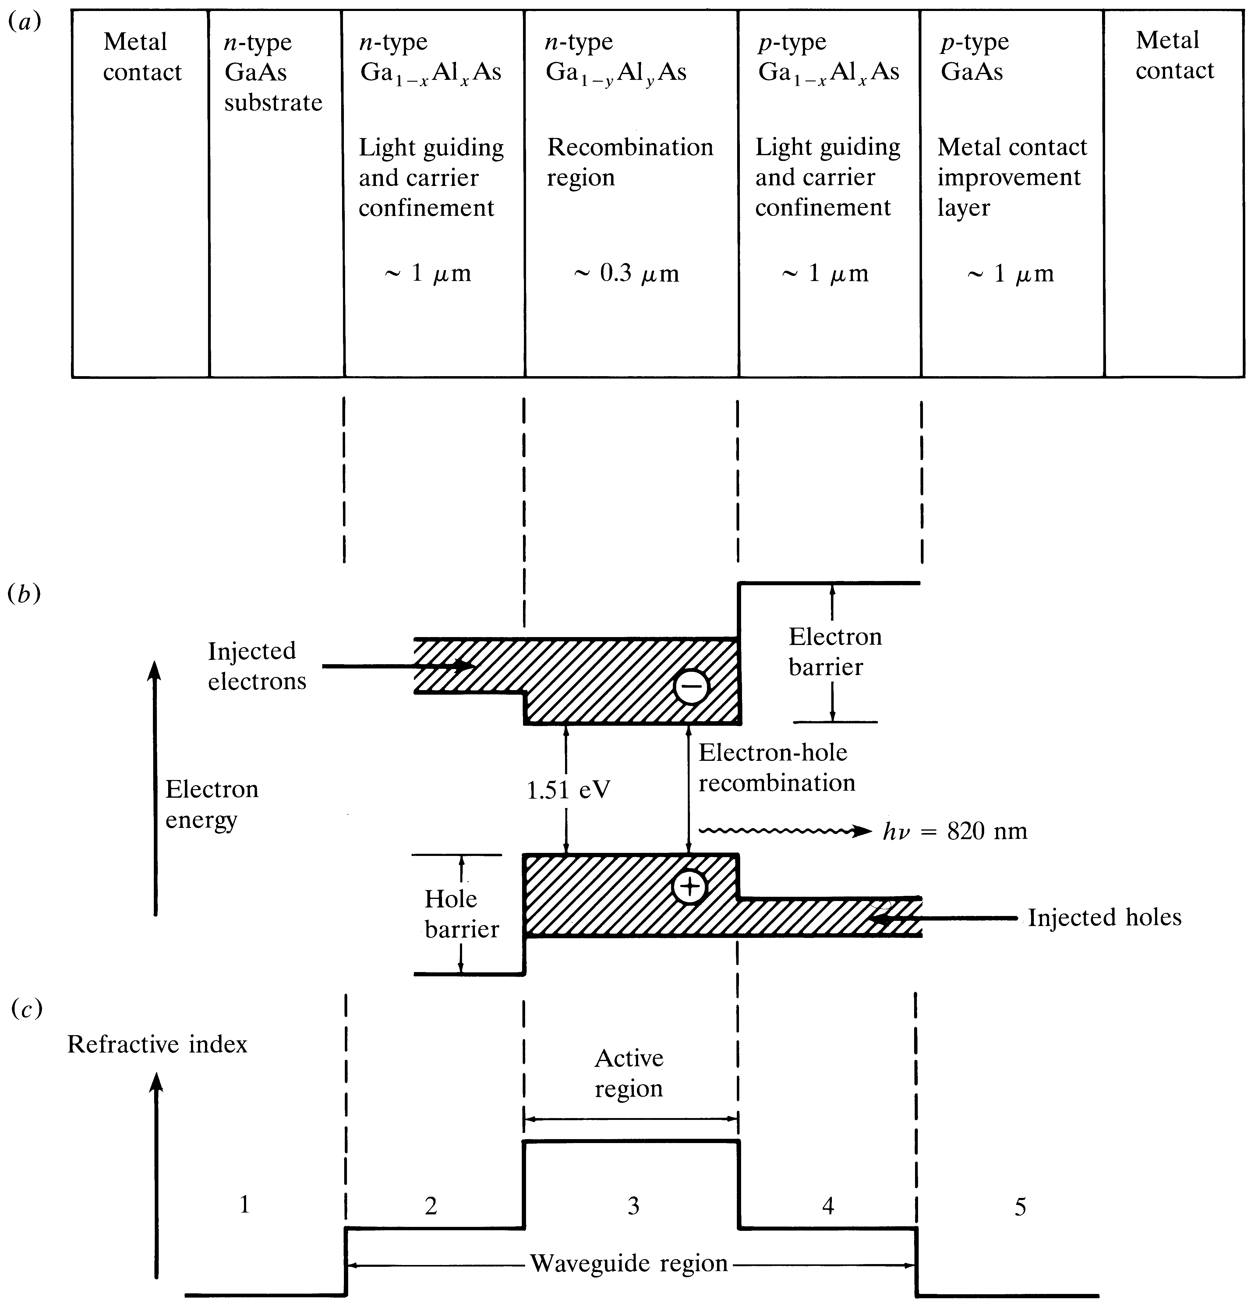
Double-Heterostructure configuration

Slide 12
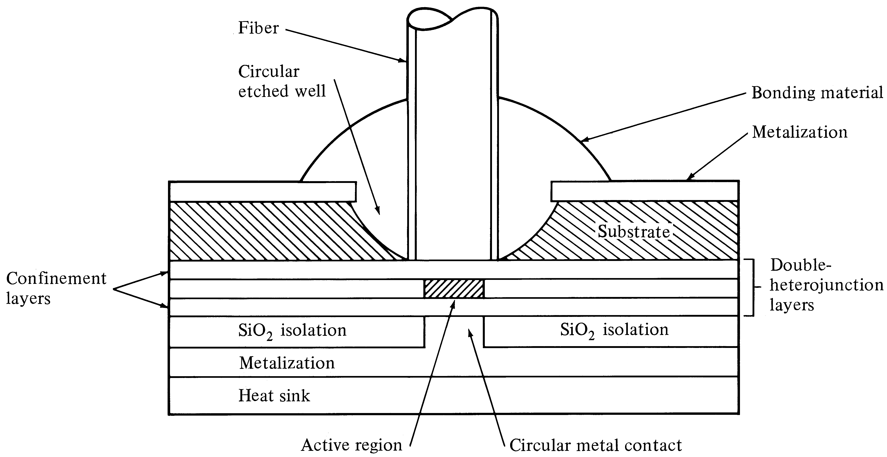
Surface-emitting LED

Slide 13
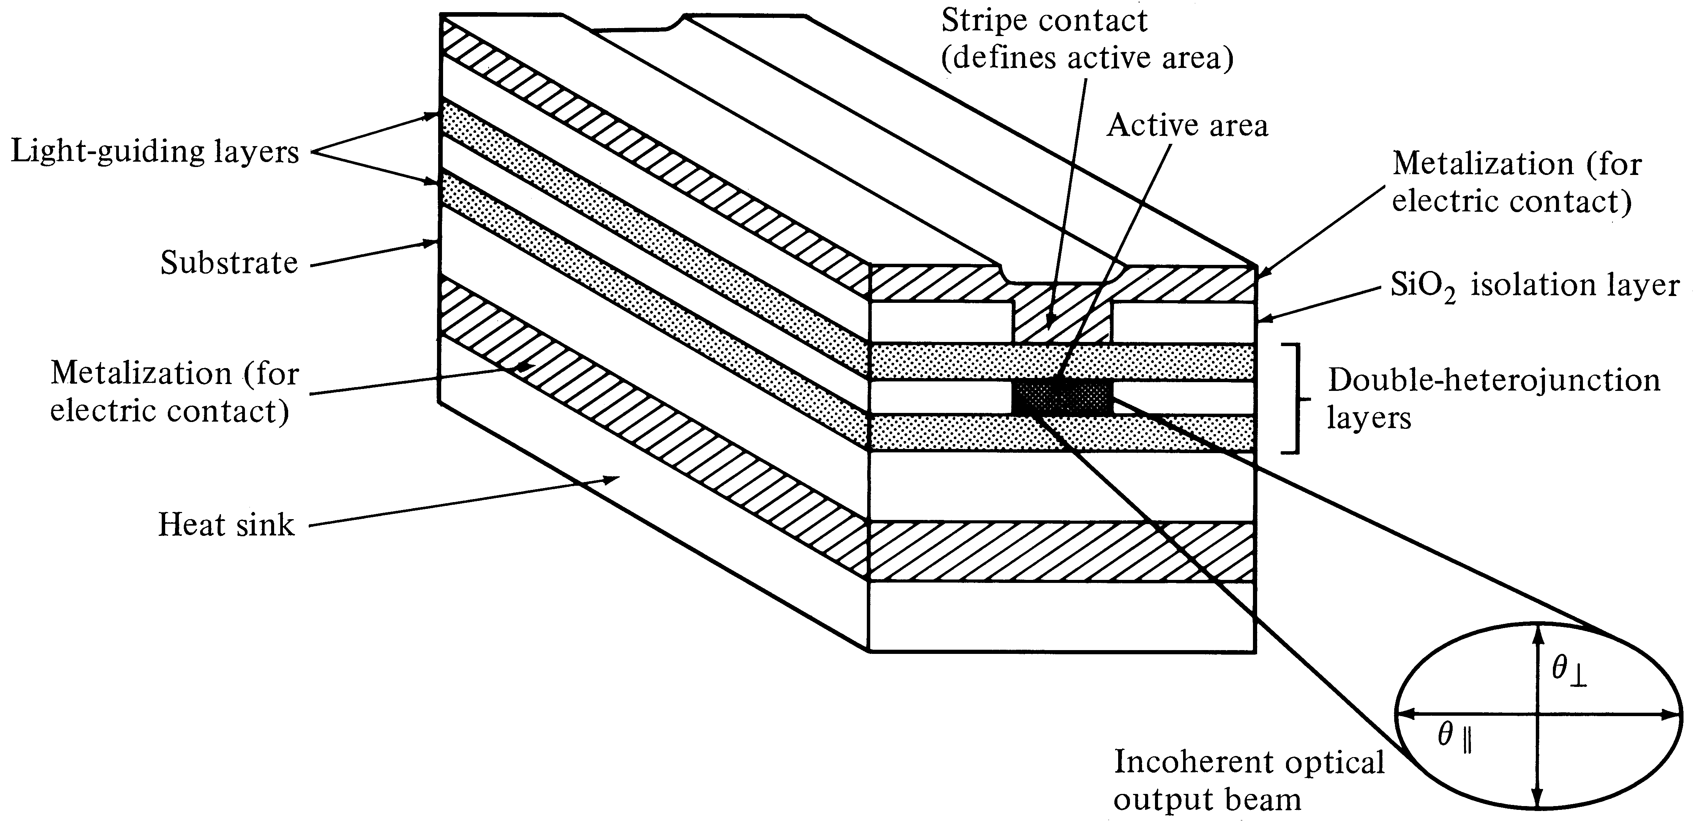
Edge-emitting LED

Slide 14
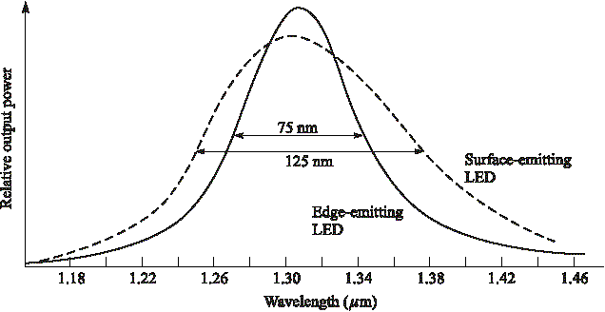
LED Spectral Width
Edge emitting LED’s have slightly narrow line width

Slide 15
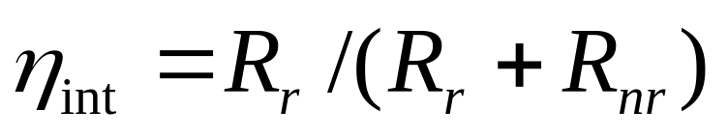
Quantum Efficiency
Internal quantum efficiency is the ratio between the radiative recombination rate and the sum of radiative and nonradiative recombination rates
For exponential decay of excess carriers, the radiative recombination lifetime is n/R_{r} and the nonradiative recombination lifetime is n/R_{nr}

Slide 16
Internal Efficiency
If the current injected into the LED is I, then the total number of recombination per second is,
R_{r}+R_{nr} = I/q where, q is the charge of an electron. That is, R_{r} = η_{int}I/q.
Since R_{r} is the total number of photons generated per second, the optical power generated internal to the LED depends on the internal quantum efficiency

Slide 17
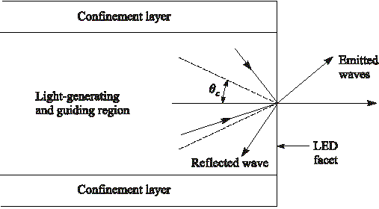
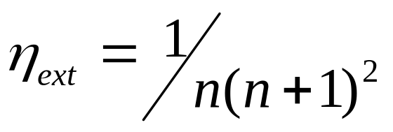
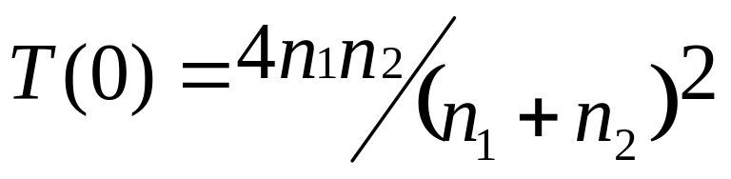
External Efficiency
n₂
n₁
Light
emission
cone
External Efficiency for air
n₂=1, n₁ = n
Fresnel Transmission Coefficient

Slide 18
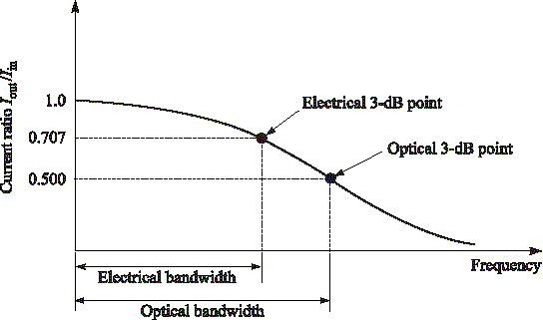
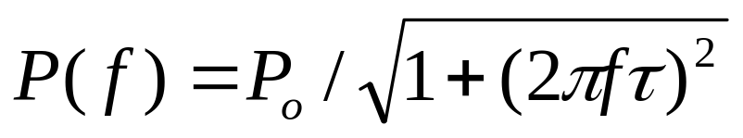
3-dB bandwidths
Optical Power ∝ I(f); Electrical Power ∝ I²(f)
Electrical Loss = 2 x Optical Loss

Slide 19
Drawbacks of LED
Large line width (30-40 nm)
Large beam width (Low coupling to the fiber)
Low output power
Low E/O conversion efficiency
Advantages
Robust
Linear

Slide 20
The LASER
Light Amplification by ‘Stimulated Emission’ and Radiation (L A S E R)
Coherent light (stimulated emission)
Narrow beam width (very focused beam)
High output power (amplification)
Narrow line width because only few wavelength will experience a positive feedback and get amplified (optical filtering)

Slide 21
Fundamental Lasing Operation
Absorption: An atom in the ground state might absorb a photon emitted by another atom, thus making a transition to an excited state.
Spontaneous Emission: random emission of a photon, which enables the atom to relax to the ground state.
Stimulated Emission: An atom in an excited state might be stimulated to emit a photon by another incident photon.

Slide 22
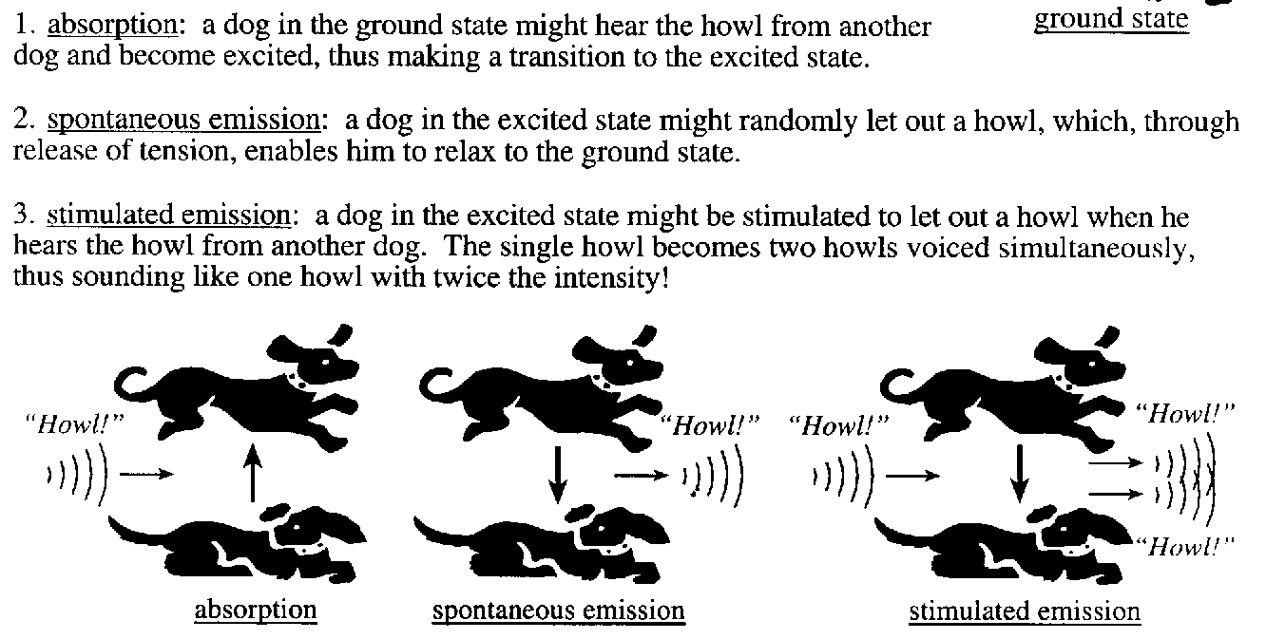
Howling Dog Analogy

Slide 23
In Stimulated Emission incident and stimulated photons will have
Identical energy → Identical wavelength → Narrow linewidth
Identical direction → Narrow beam width
Identical phase → Coherence and
Identical polarization

Slide 24
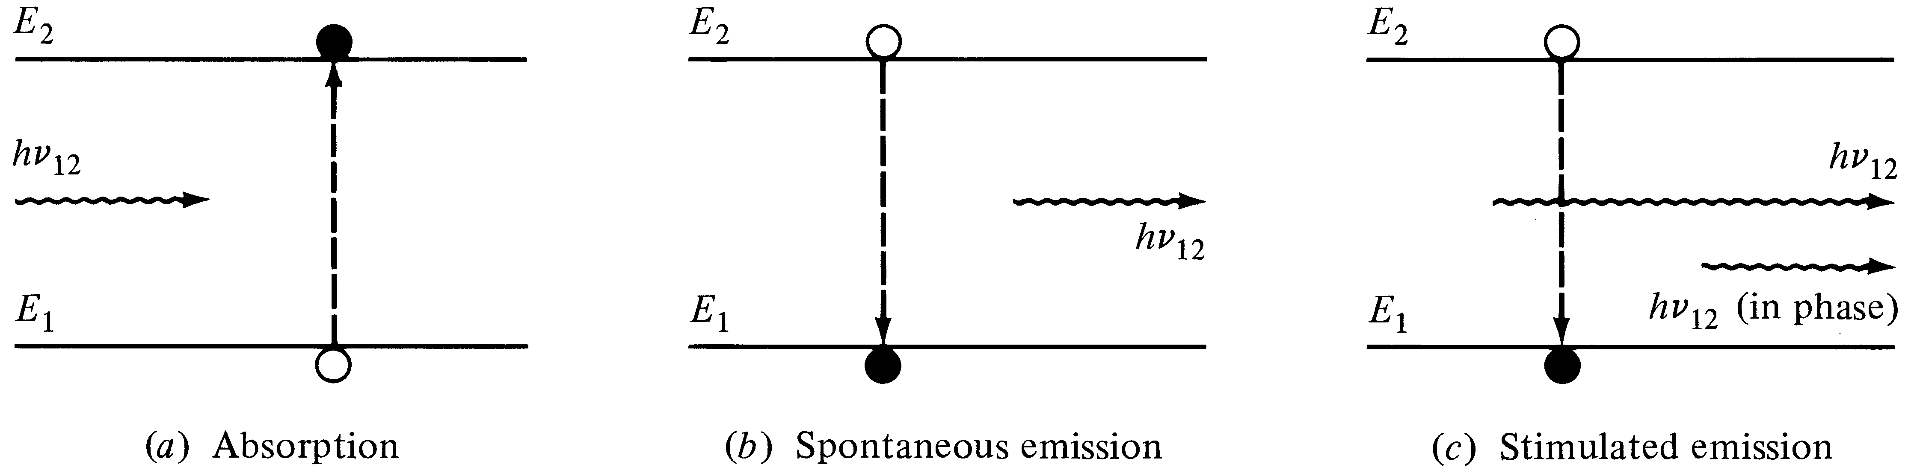
Laser Transition Processes
(Stimulated and Spontaneous Emission)
Energy absorbed from the incoming photon | Random release of energy | Coherent release of energy

Slide 25
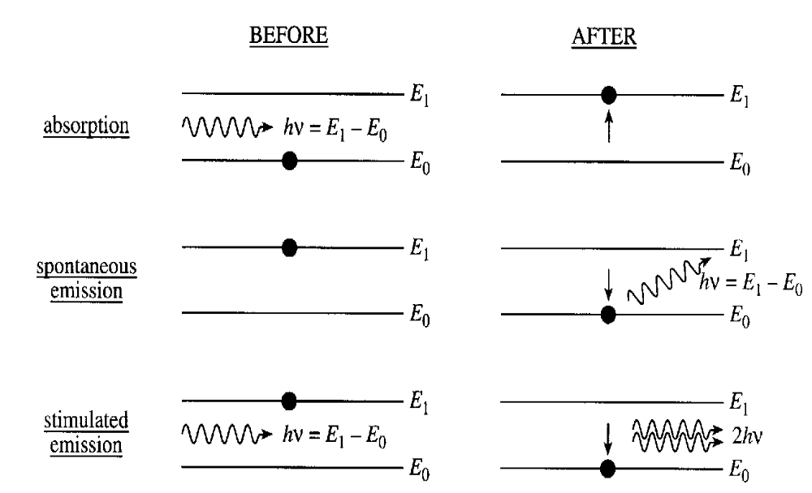
Stimulated Emission

Slide 26
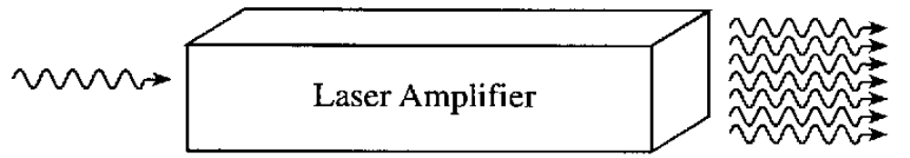
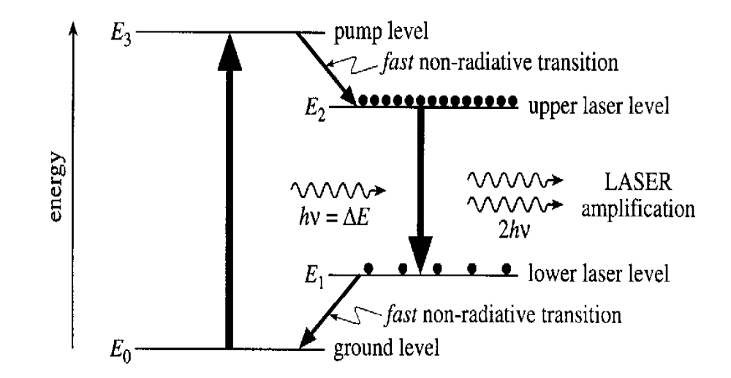

Slide 27
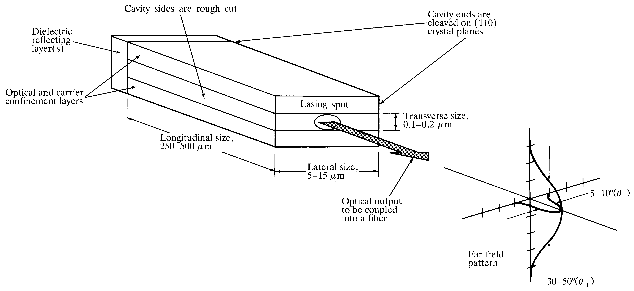
Fabry-Perot Laser (resonator) cavity

Slide 28
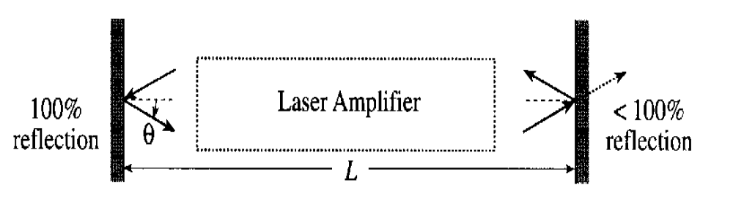
Mirror Reflections

Slide 29
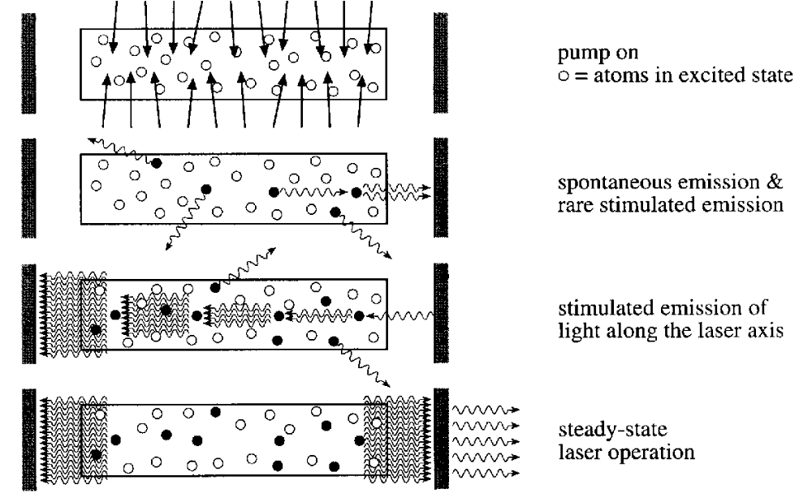
How a Laser Works

Slide 30
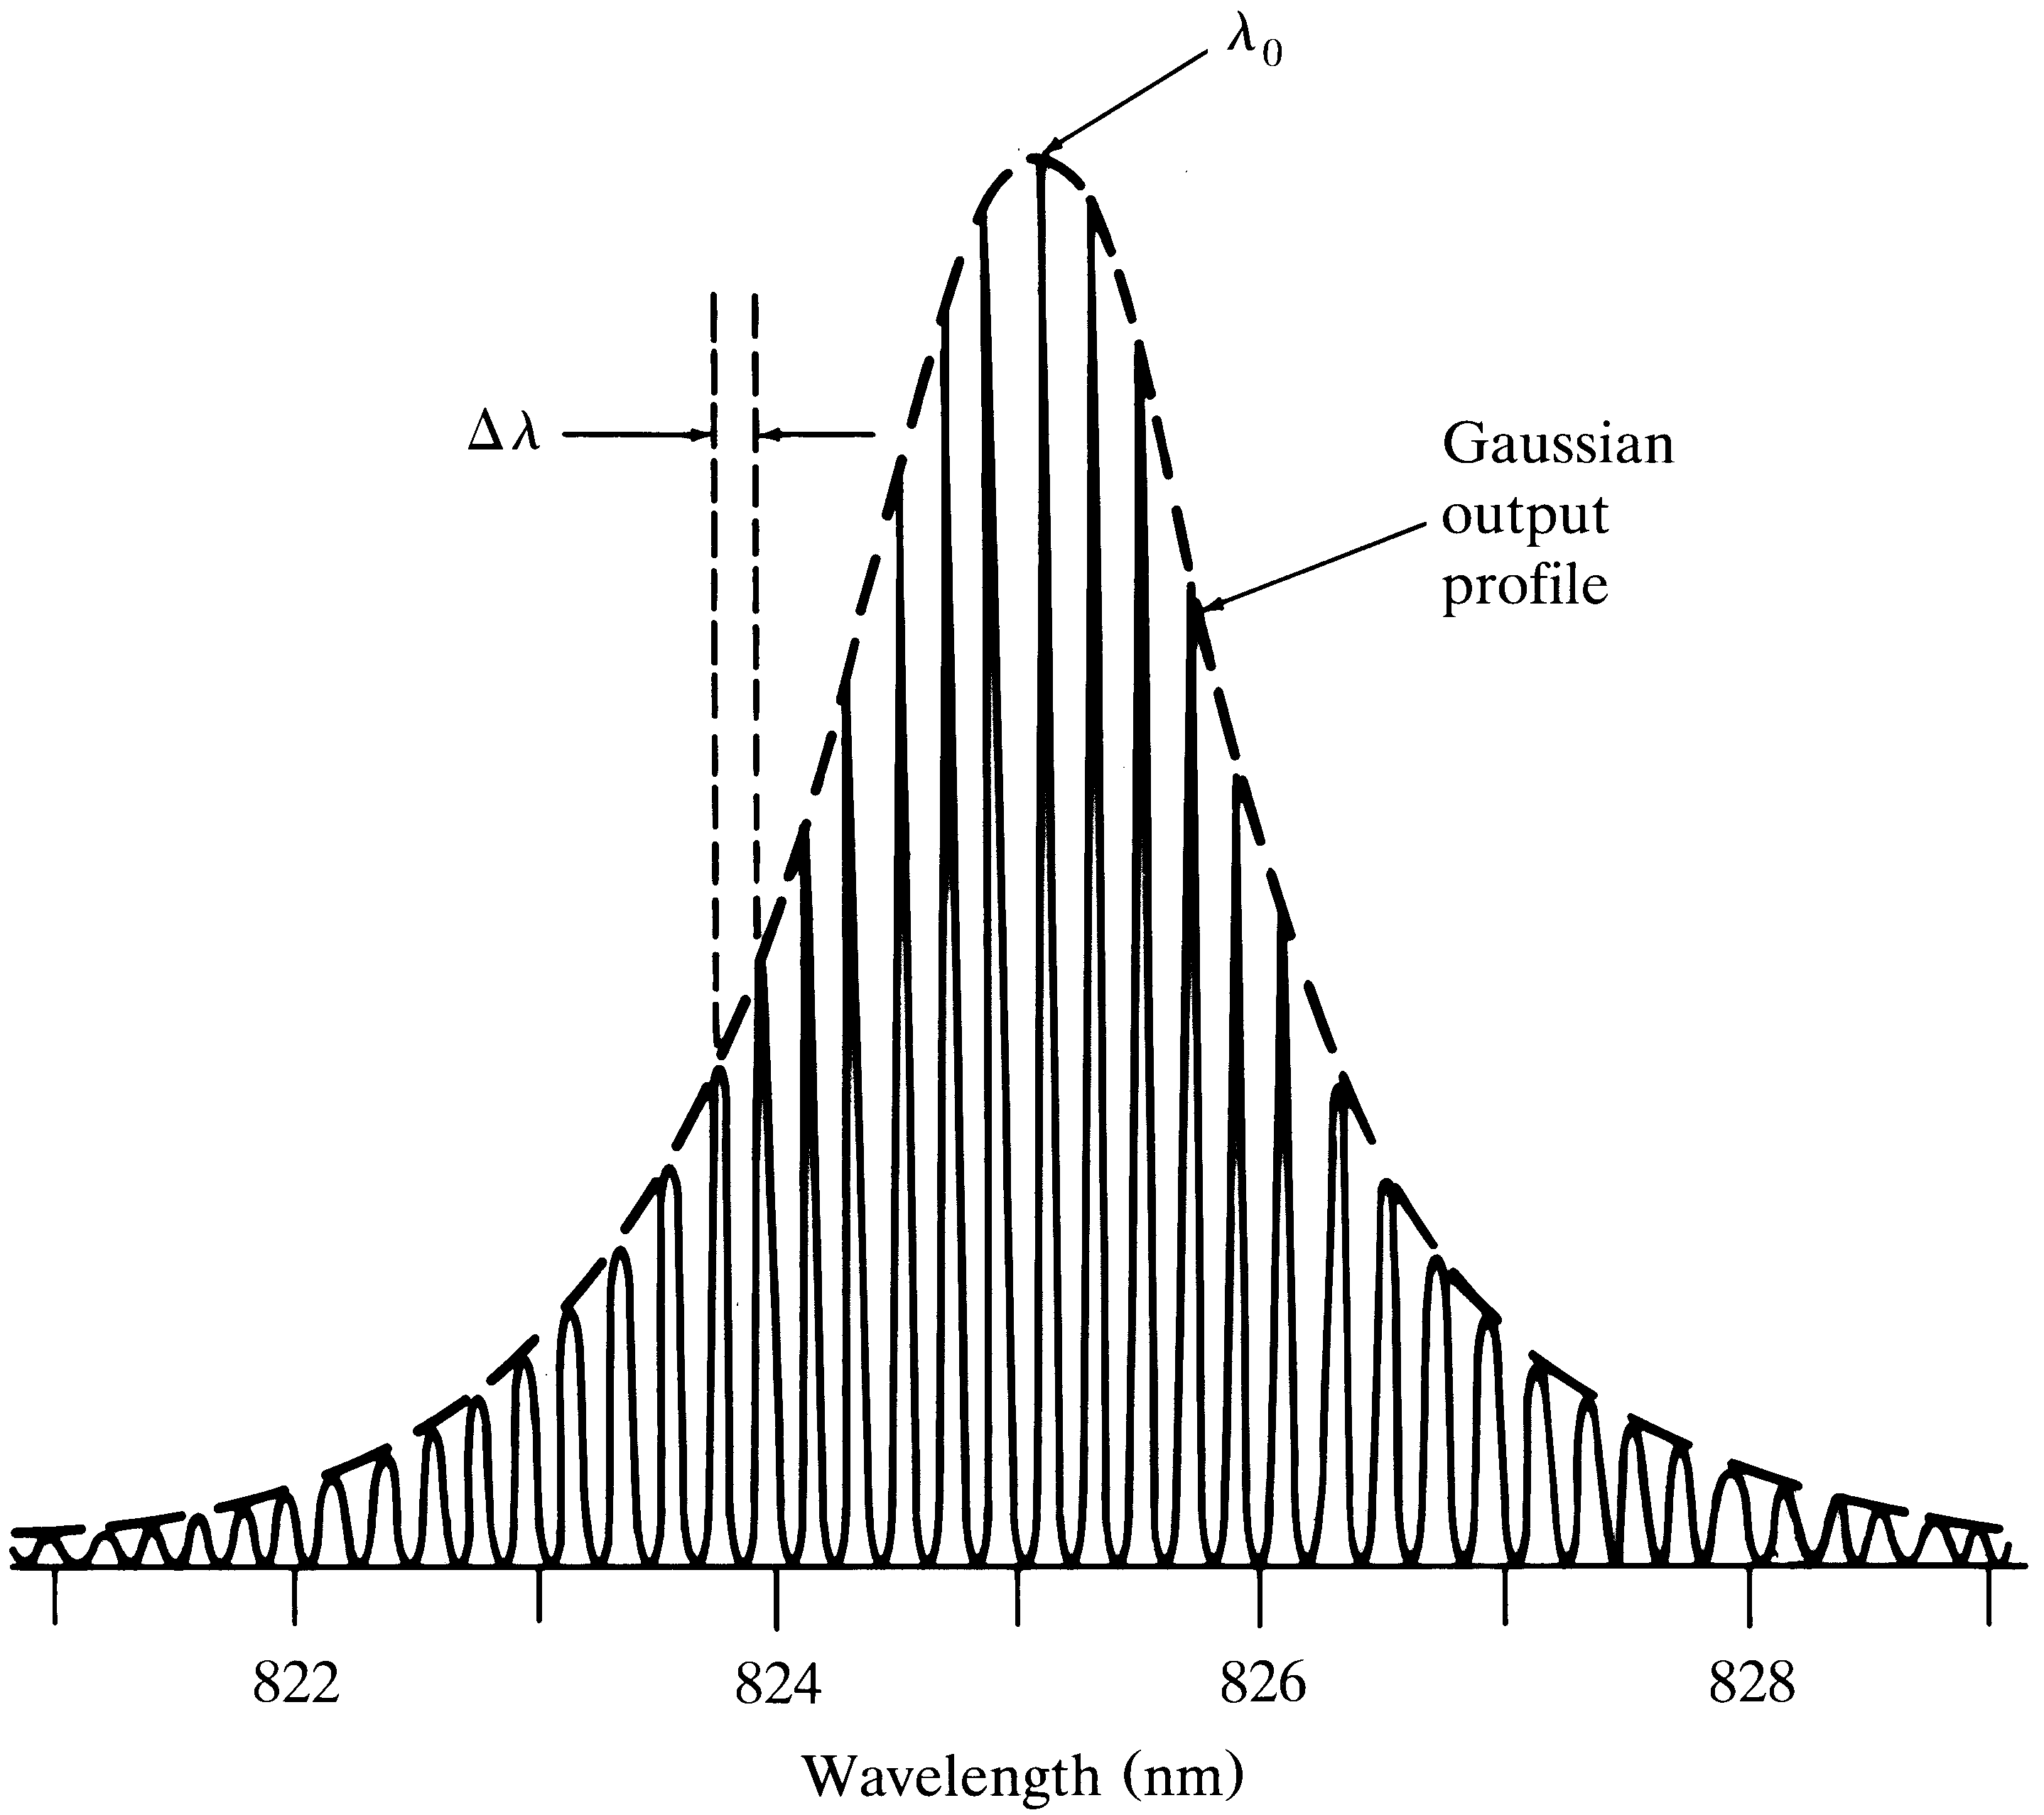
Multimode Laser Output
Spectrum
(Center Wavelength)
Mode
Separation
g(λ)
Longitudinal
Modes

Slide 31
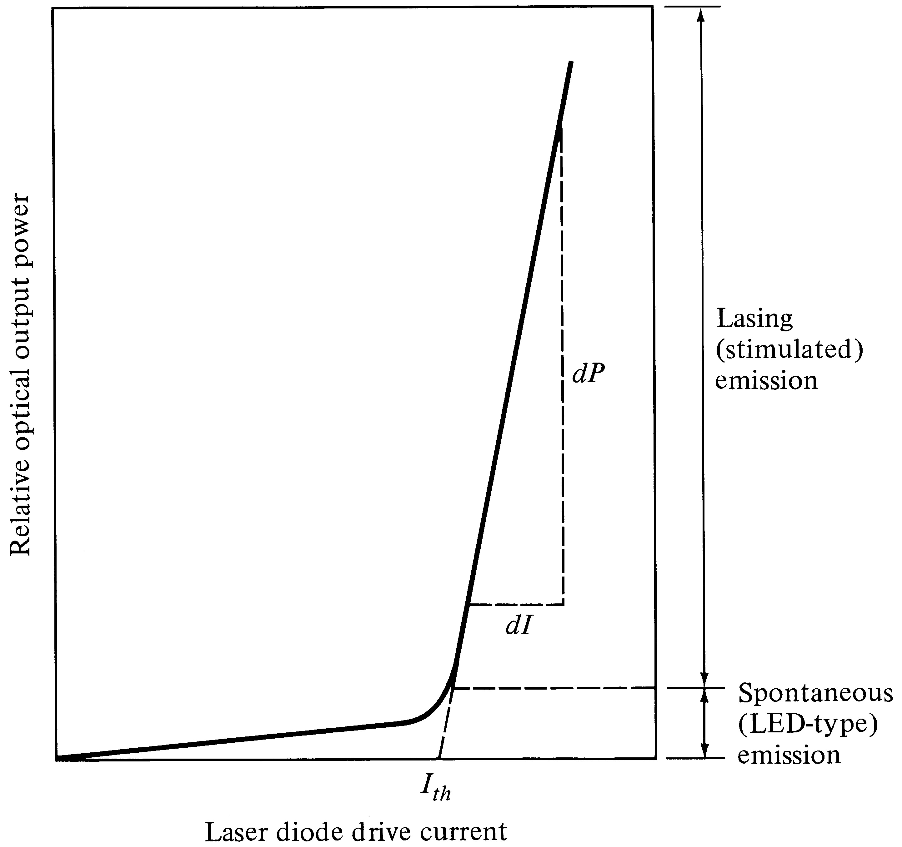
Optical output vs. drive current of a laser
External Efficiency
Depends on the slope
Threshold Current

Slide 32
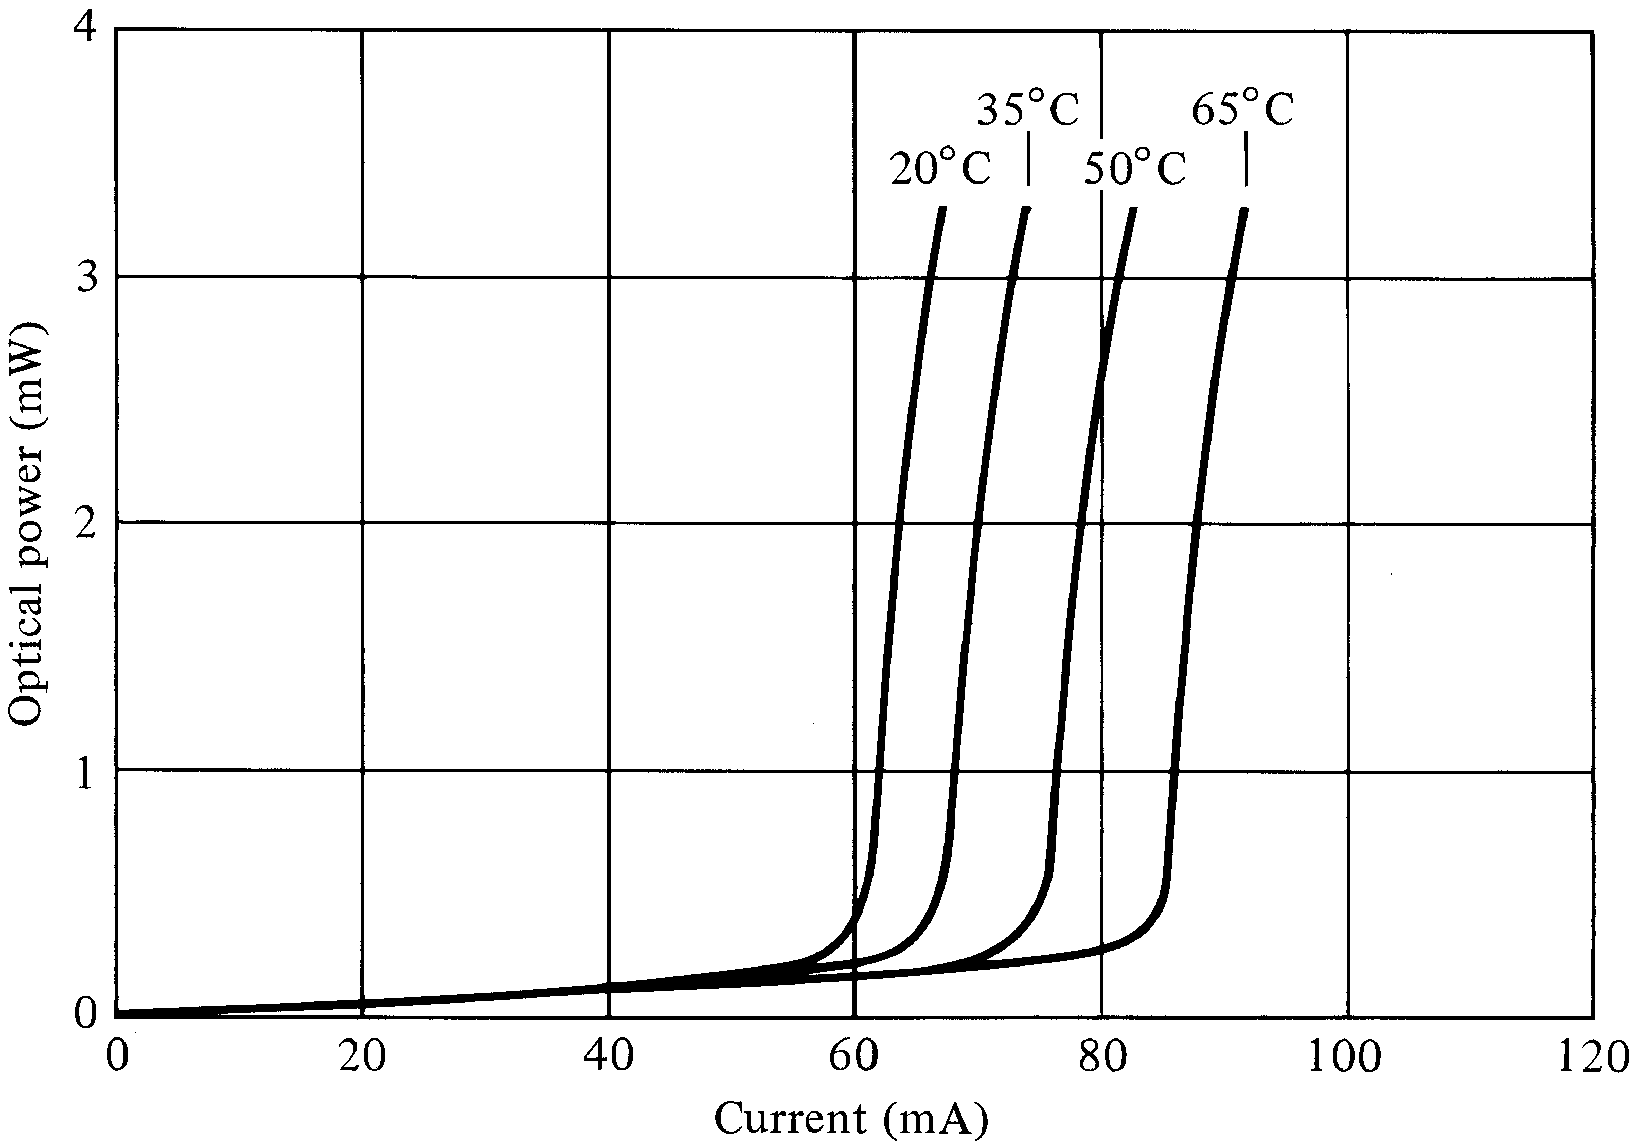
Laser threshold depends on Temperature

Slide 33
Modulation of Optical Sources
Optical sources can be modulated either directly or externally.
Direct modulation is done by modulating the driving current according to the message signal (digital or analog)
In external modulation, the laser is emits continuous wave (CW) light and the modulation is done in the fiber

Slide 34
Why Modulation
A communication link is established by transmission of information reliably
Optical modulation is embedding the information on the optical carrier for this purpose
The information can be digital (1,0) or analog (a continuous waveform)
The bit error rate (BER) is the performance measure in digital systems
The signal to noise ratio (SNR) is the performance measure in analog systems

Slide 35
Types of Optical Modulation
Direct modulation is done by superimposing the modulating (message) signal on the driving current
External modulation, is done after the light is generated; the laser is driven by a dc current and the modulation is done after that separately
Both these schemes can be done with either digital or analog modulating signals

Slide 36
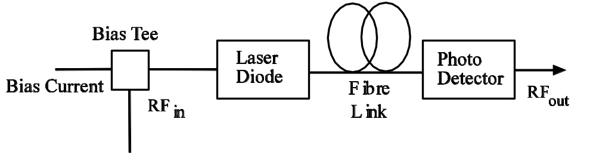
Direct Modulation
The message signal (ac) is superimposed on the bias current (dc) which modulates the laser
Robust and simple, hence widely used
Issues: laser resonance frequency, chirp, turn on delay, clipping and laser nonlinearity

Slide 37
Optical Output vs. Drive Current of a Laser

Slide 38
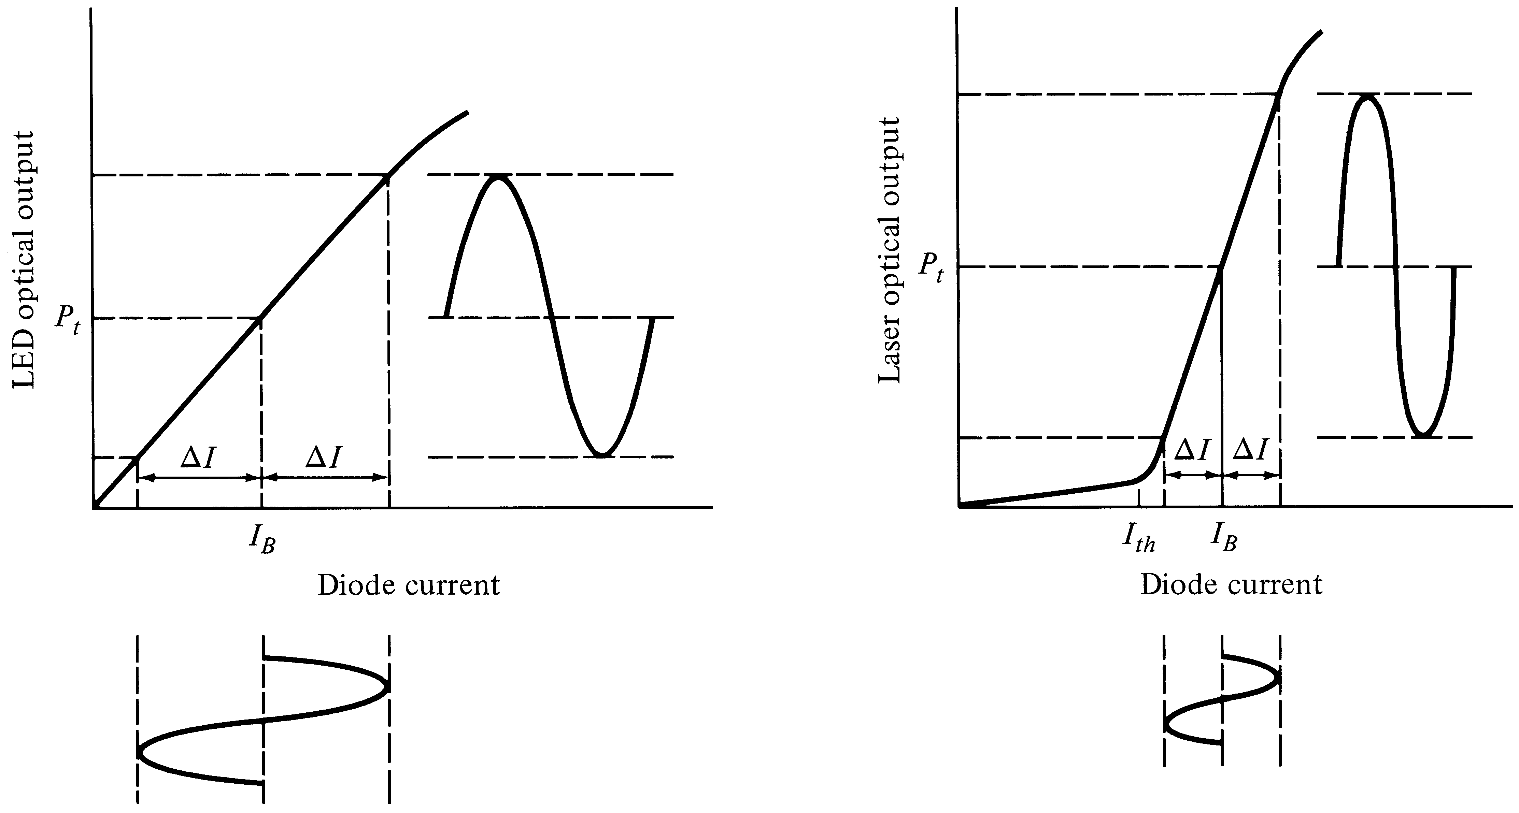
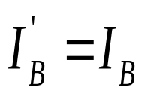
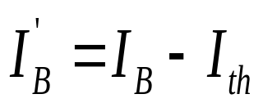
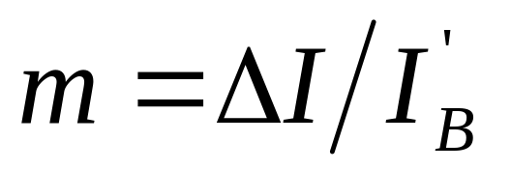
Direct Analog Modulation
LED
LASER
Modulation index (depth)

Slide 39
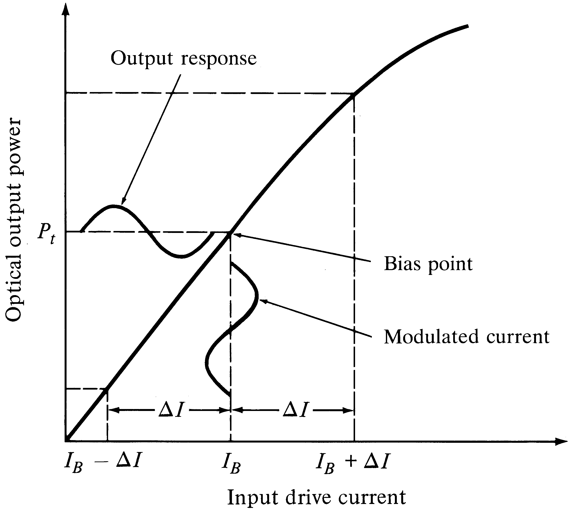
Analog LED Modulation
Note:
No threshold
current
No clipping
No turn on delay

Slide 40
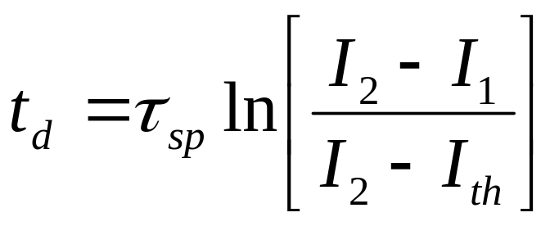
Laser Digital Modulation
Optical
Power
(P)
P(t)
I_{th}
I₁
I₂
t
Current (I)
I(t)
t

Slide 41

Turn on Delay (lasers)
When the driving current suddenly jumps from low (I₁ < I_{th}) to high (I₂ > I_{th}) , (step input), there is a finite time before the laser will turn on
This delay limits bit rate in digital systems
Can you think of any solution?

Slide 42
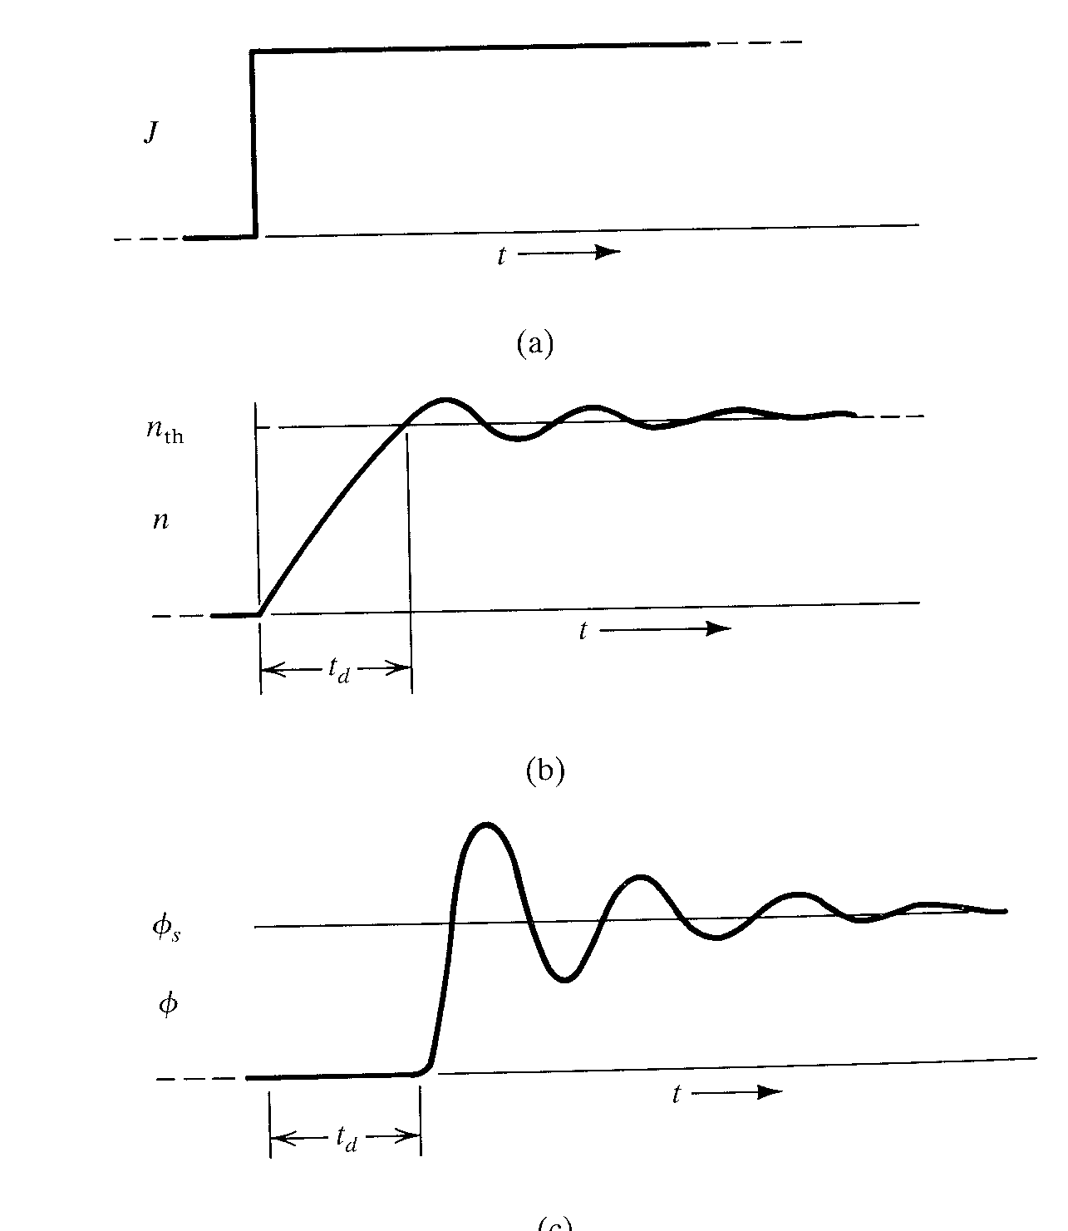
I₂
Input current
  Assume step input
Electron density
  steadily increases until threshold value is reached
Output optical power
  Starts to increase only after the electrons reach the threshold
I₁
Turn
on
Delay
(t_{d})
Resonance Freq.
(f_{r})

Slide 43
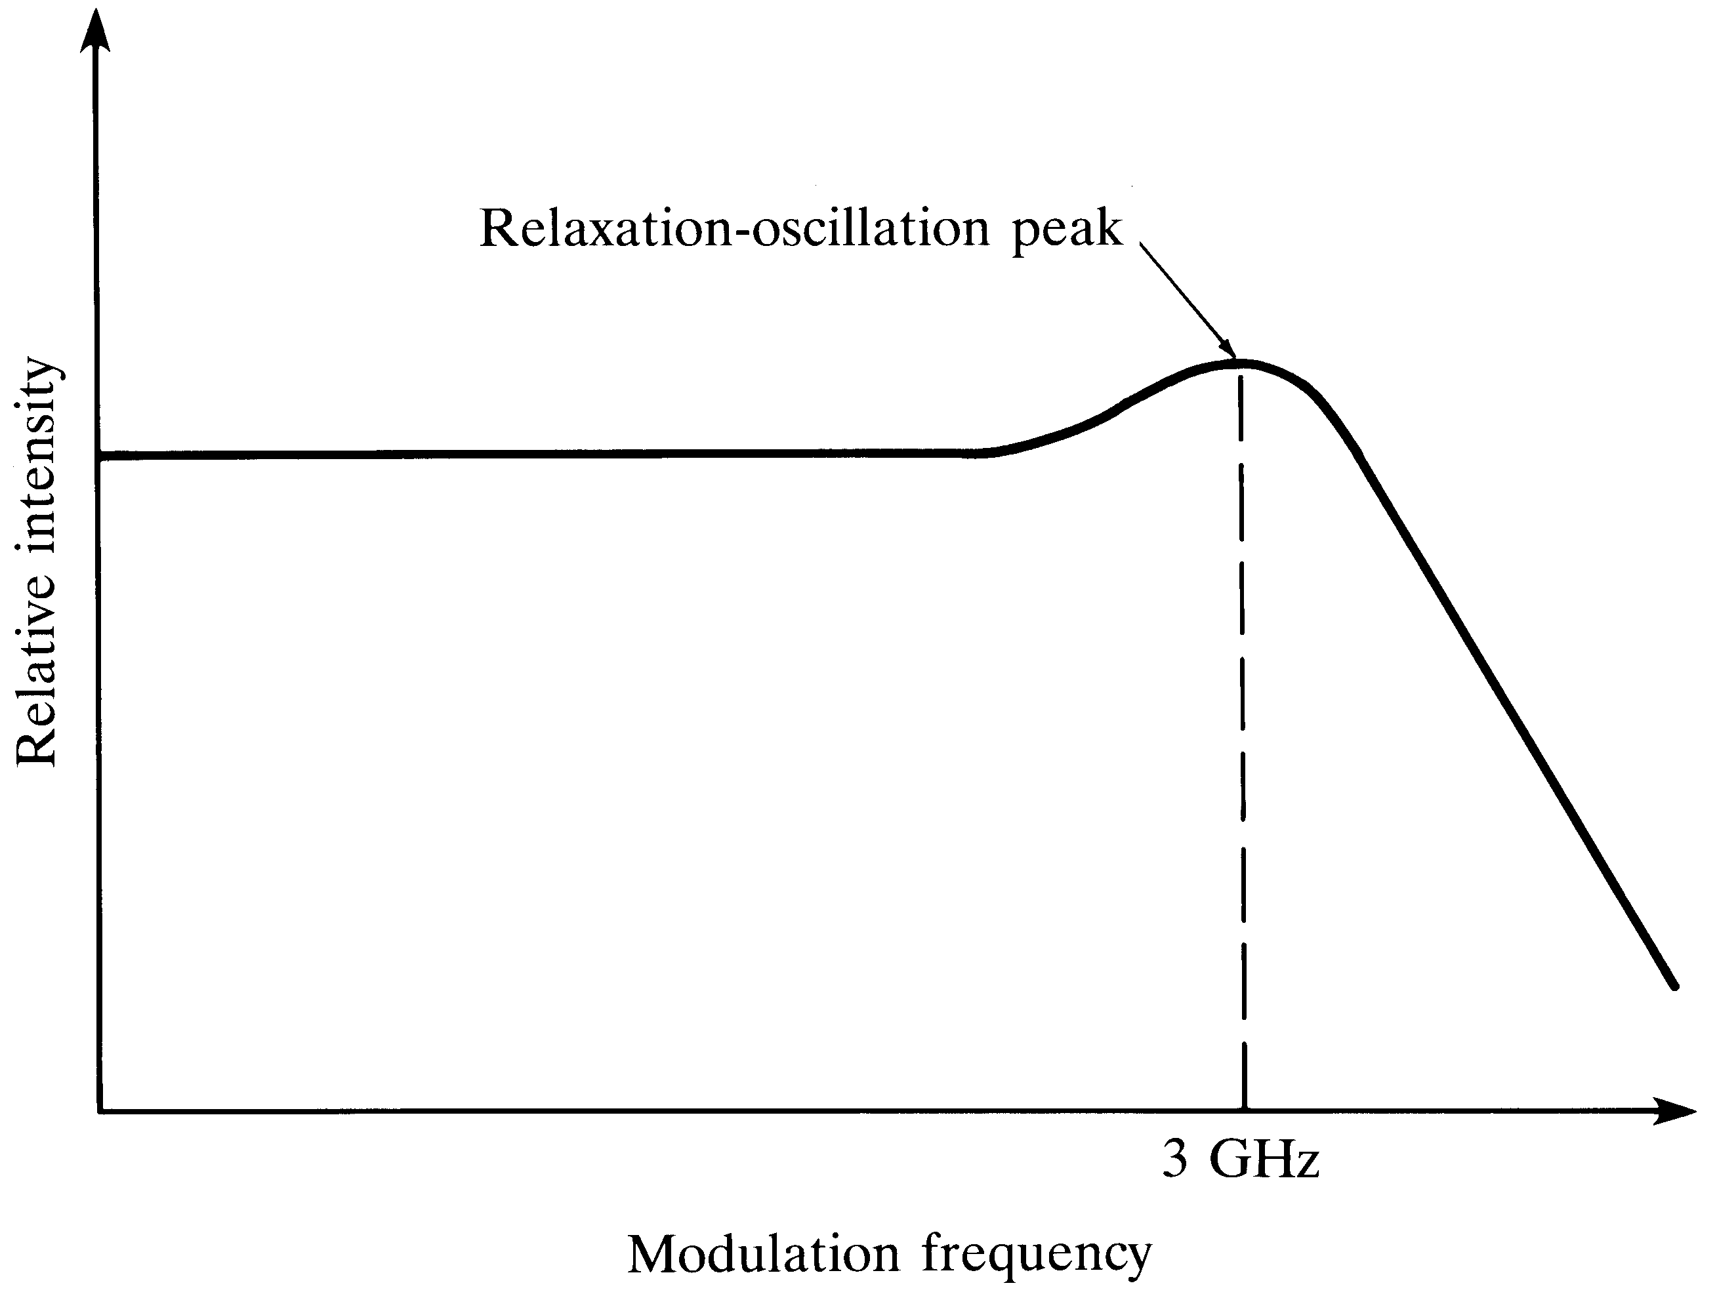
Frequency Response of a Laser
Resonance Frequency
(f_{r}) limits the highest possible modulation frequency
Useful Region

Slide 44
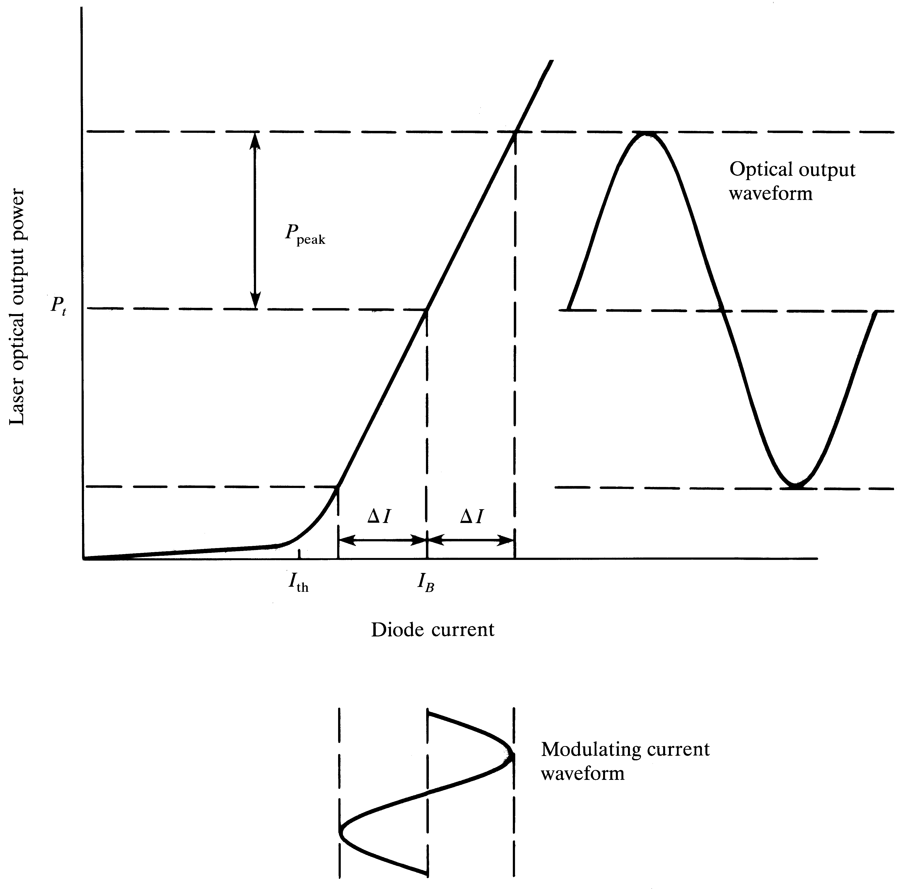
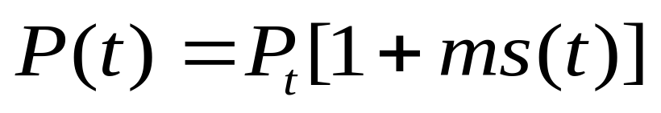
Laser Analog
Modulation
P(t)
Here s(t) is the modulating signal,
P(t): output optical power
P_{t}: mean value
S(t)

Slide 45
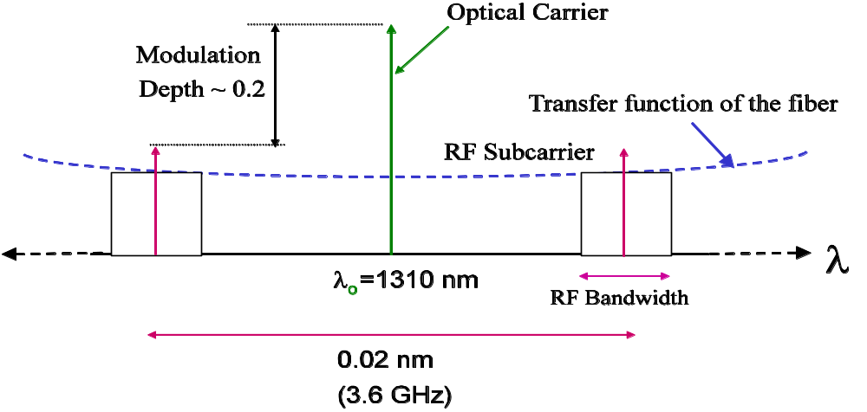
The modulated spectrum
Twice the RF frequency
Two sidebands each separated by modulating frequency

Slide 46
Limitations of Direct Modulation
Turn on delay and resonance frequency are the two major factors that limit the speed of digital laser modulation
Saturation and clipping introduces nonlinear distortion with analog modulation (especially in multi carrier systems)
Nonlinear distortions introduce second and third order intermodulation products
Chirp: Laser output wavelength drift with modulating current is also another issue

Slide 47
Temperature dependency of the laser is another issue

Slide 48
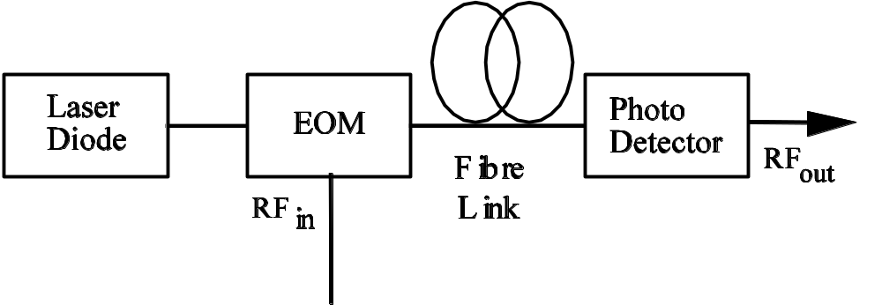
External Optical Modulation
Modulation and light generation are separated
Offers much wider bandwidth → up to 60 GHz
More expensive and complex
Used in high end systems

Slide 49
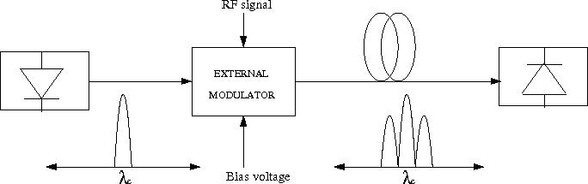
External Modulated Spectrum
Typical spectrum is double side band
However, single side band is possible which is useful at extreme RF frequencies

Slide 50
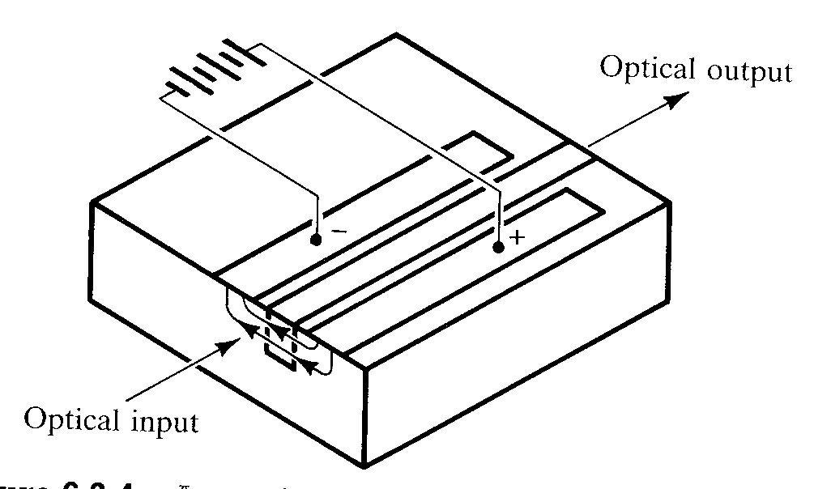
An Optical Phase External Modulator
Refractive index of the optical waveguide changes depending on the applied electric field

Slide 51
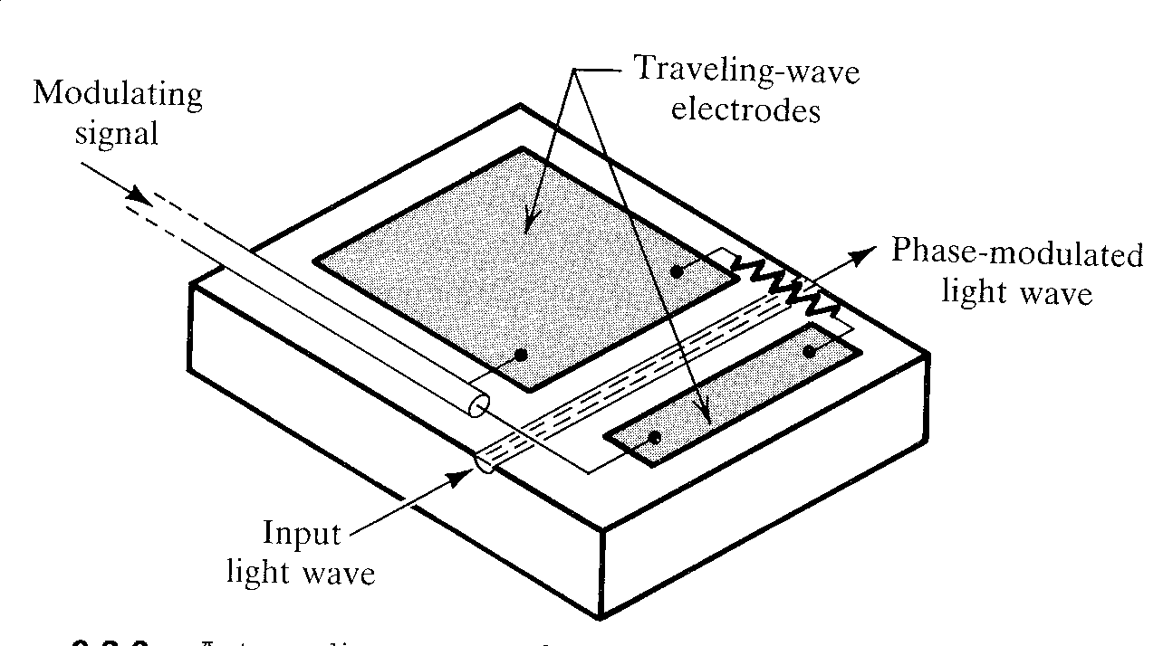
A Traveling Wave Phase Mod.
Much wideband operation is possible due to the traveling wave tube arrangement

Slide 52
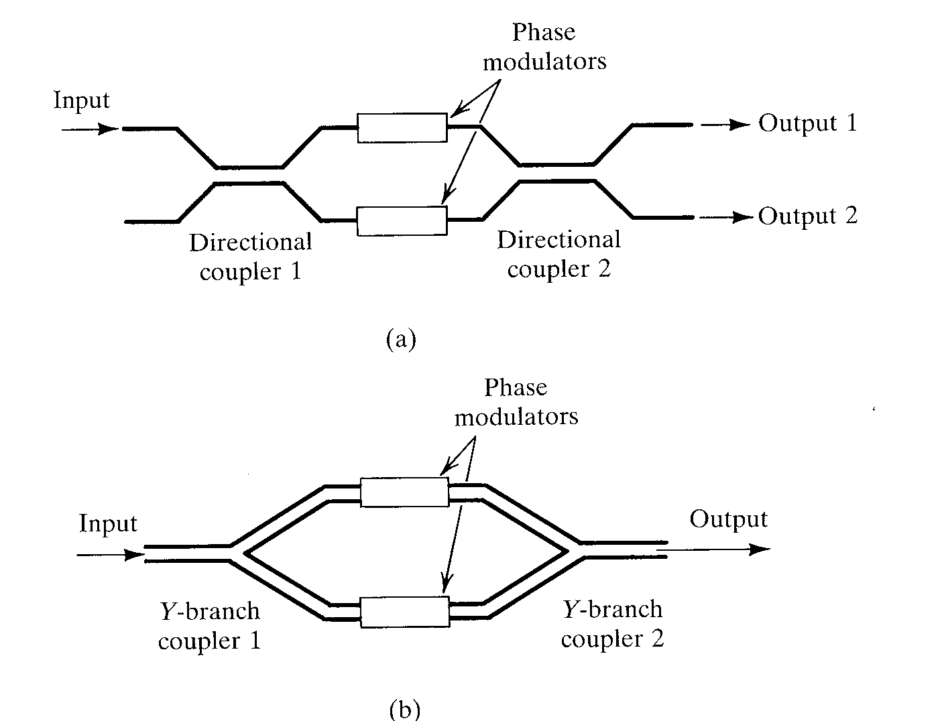
Mach-Zehnder Interferometers

Slide 53
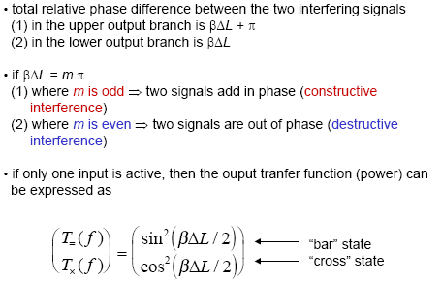
Mach-Zehnder Principle

Slide 54
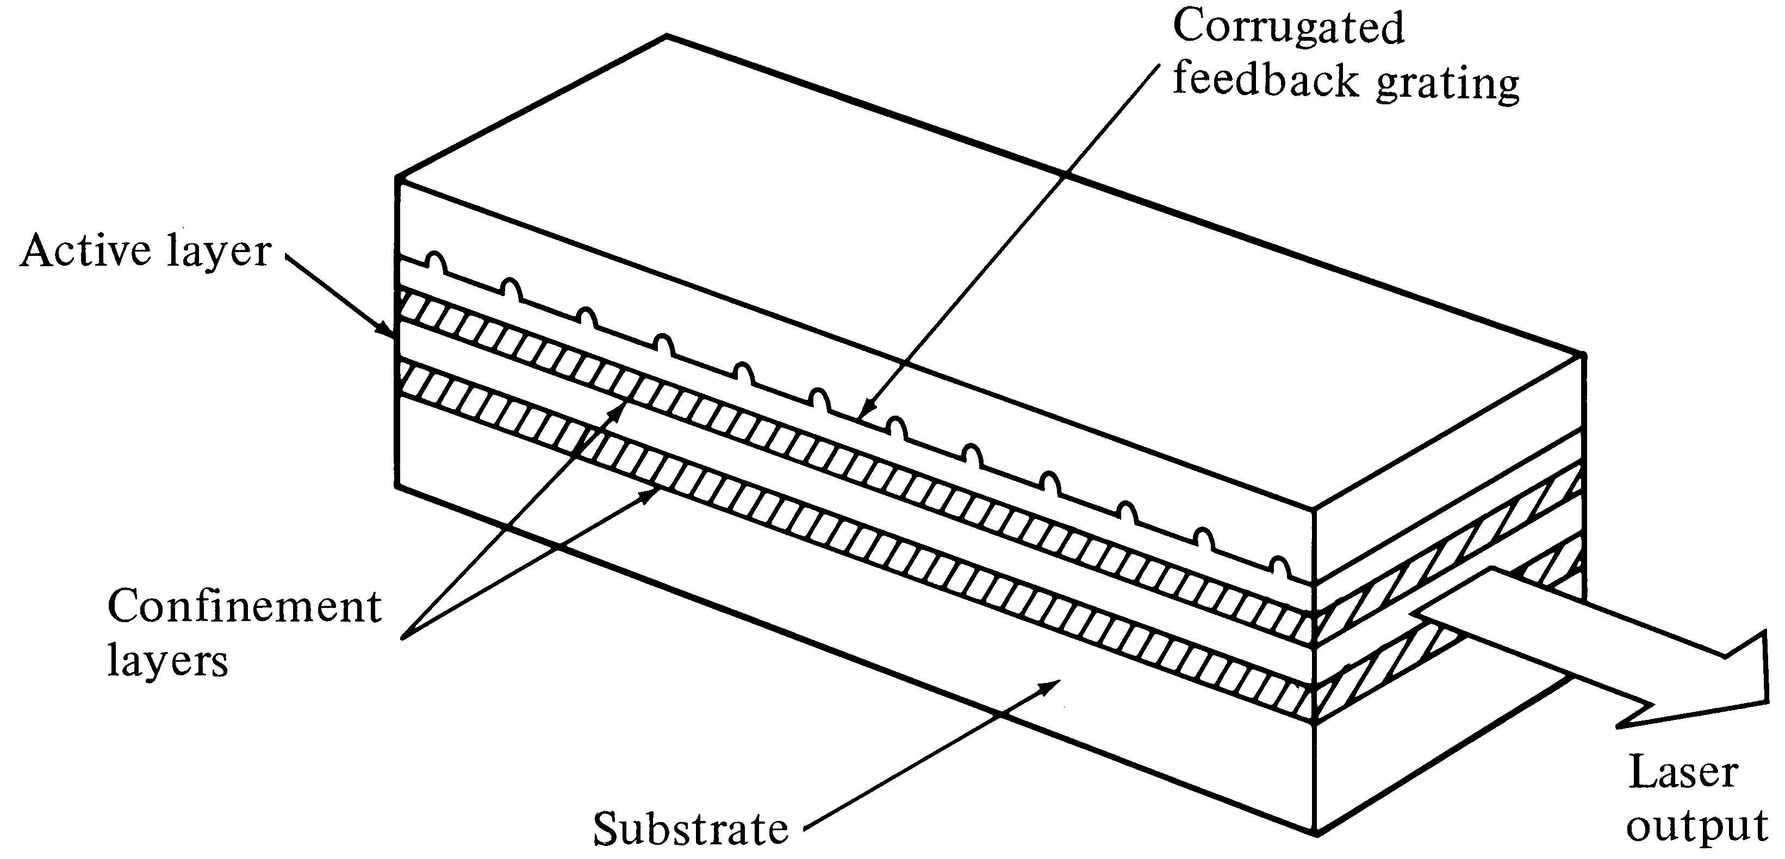
Distributed Feedback Laser
(Single Mode Laser)
The optical feedback is provided by fiber Bragg Gratings
→ Only one wavelength get positive feedback

